Slide 1
ESc201 : Introduction to Electronics
Logic Gates and Minimization
Vipul Arora
Dept. of Electrical Engineering
IIT Kanpur
Mar 27, 2023

Slide 2
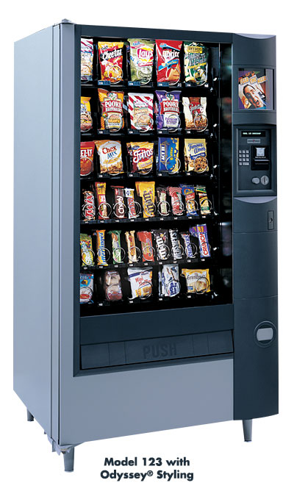
How do we get the chocolate?

Slide 3
Design Flow
System Description
Truth Table
Boolean Expression
Minimized
Boolean Expression
Gate Netlist

Slide 4
Goal of Simplification
Goal of simplification is to reduce the complexity of gate circuit. This requires that we minimize the number of gates.

Slide 5
circuit-1
circuit-2
Circuit-2 is simpler because it uses
one 2-input and three 3-input gates as compared to
four 3-input and one 4-input gates used in circuit-1

Slide 6
Minimization

Slide 7
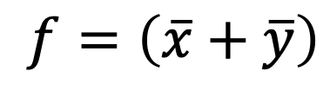
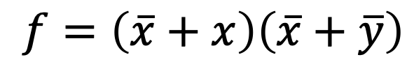
$$f=\left(\overline{x}+x\right)\left(\overline{x}+\overline{y}\right)$$
$$f=\left(\overline{x}+\overline{y}\right)$$

Slide 8
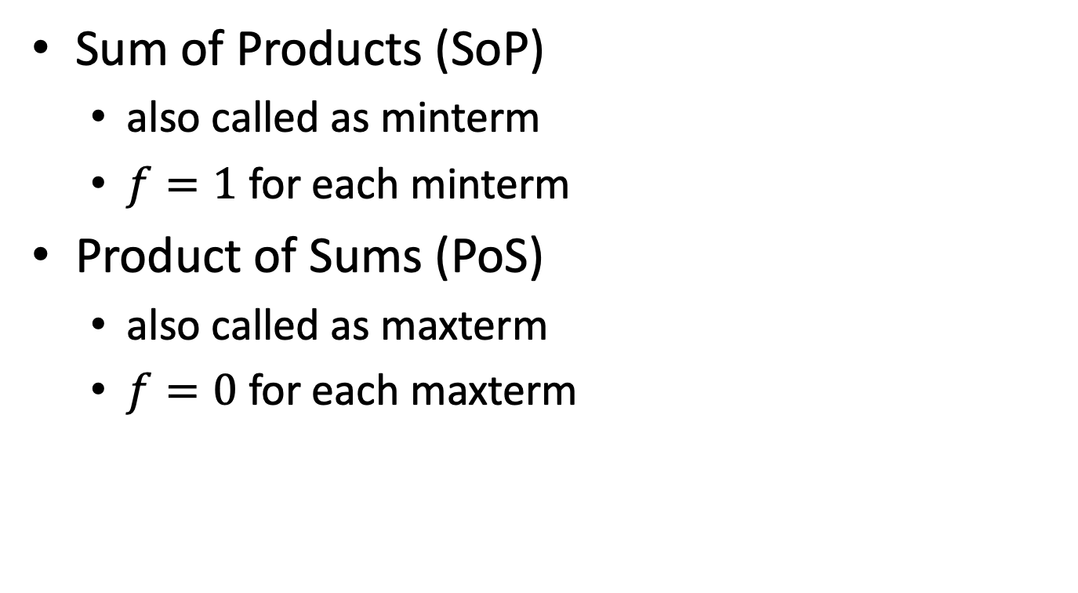
Two ways to represent functions
Sum of Products (SoP)
also called as minterm
$f=1$ for each minterm
Product of Sums (PoS)
also called as maxterm
$f=0$ for each maxterm

Slide 9
SoP (minterm) Representation of Boolean
Expressions
A minterm is a product that contains all the variables used in a function

Slide 10
Example: Three variable functions

Slide 11
PoS (maxterm) Representation of Boolean
Expressions
A maxterm is a sum that contains all the variables used in a function

Slide 12
Example: Three variable functions

Slide 13
Need a systematic and simpler method
Karnaugh Map (K map) is a popular technique for carrying out simplification
It represents the information in problem in such a way that the two principles become easy to apply

Slide 14
K-map representation of truth table
Draw K-map for this truth table
E.g., draw K-map for this truth table

Slide 15
Expression to K-map
This means
f(x,y) = 1 for xy = 01, 10, 11
K-map to Expression

Slide 16
3-variable K-map representation
Truth Table to K-map
Note: Every neighbor has only ONE term different

Slide 17
3-variable K-map representation

Slide 18
What is the function represented by this K map?

Slide 19
4-variable K-map representation

Slide 20
K-map Minimization
Reduce the neighbors

Slide 21
Minimization using Kmap
Combine neighbors.
Common terms remain; different ones are reduced

Slide 22
Confirm

Slide 23
The idea is to cover all the 1’s with as few and as simple terms as possible

Slide 24
3-variable minimization

Slide 25
3-variable minimization

Slide 26
3-variable minimization

Slide 28
Can we do this ?
Note that each encirclement should represent a single product term. In this case it does not.
We do not get a single product term. In general we cannot make groups of 3 terms.

Slide 29
Can we use kmap with the following ordering of variables?
Can we combine these two terms into a single term ?
Note that no simplification is possible.

Slide 30
These two terms can be combined into a single term but it is not easy to show that on the diagram.
Kmap requires information to be represented in such a way that it is easy to apply the principle

